Slide 1

SDET Course
Design Patterns - Prototype

Slide 2
3 Types of Design Patterns
Creational
Singleton
Builder
Prototype
Factory Method
Abstract Factory
Structural
Adapter
Composite
Proxy
Flyweight
Bridge
Facade
Decorator
Behavioral
Strategy
Observer
Command
Memento
State
Template Method
Mediator
Chain of Responsibility
Interpreter
Visitor
Iterator

Slide 3
Agenda
Description
Diagram
Code sample (Java)
Use cases

Slide 4

The Problem
Introduction - The Cloned Teddy Bear

Slide 5
The Problem
Option 1
Option 2
CopyObject co = new CopyObject(1, 2, new Object());
CopyObject co2 = new CopyObject();
co2.a = co.getA();
co2.b = co.getB();
co2.c = co.c; // private member - cannot copy
co2.o = co.getO();
public class CopyObject {
private int a;
private int b;
private Object o;
public CopyObject(int a, int b, Object o) {
this.a = a;
this.b = b;
this.o = o;
}
}
Cannot access private members
The interface issue (does not hold all members)
Tightly coupled
Shallow copy
Concrete class

Slide 6
Shallow / Deep Copy
public class ShallowCopy {
private int a;
private int b;
private Object o;
public ShallowCopy(int a, int b, Object o) {
this.a = a;
this.b = b;
this.o = o;
}
public ShallowCopy(ShallowCopy sc) {
this.a = sc.a;
this.b = sc.b;
this.o = sc.o;
}
}
ShallowCopy sc = new ShallowCopy(1, 2, new Object());
ShallowCopy sc2 = new ShallowCopy(sc);
Assertions.assertEquals(sc.o, sc2.o);
sc
Object o
sc2

Slide 7
Shallow / Deep Copy
public class DeepCopy {
private int a;
private int b;
private Object o;
public DeepCopy(int a, int b, Object o) {
this.a = a;
this.b = b;
this.o = o;
}
public DeepCopy(DeepCopy dc) {
this.a = dc.a;
this.b = dc.b;
this.o = new Object(dc.o);
}
}
DeepCopy dc = new DeepCopy(1, 2, new Object());
DeepCopy dc2 = new DeepCopy(dc);
Assertions.assertNotEquals(dc.o, dc2.o);
Object o2
sc2
Object o1
sc

Slide 8
Description
The Prototype pattern is used when the type of objects to create is determined by a prototypical instance, which is cloned to produce new objects. This pattern is particularly useful when the cost of creating an object is heavier than cloning it

Slide 9
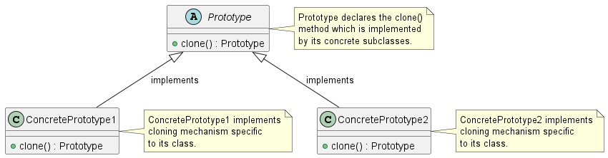
Class Diagram

Slide 10
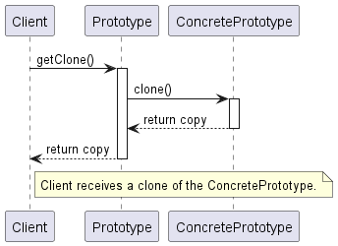
Sequence Diagram

Slide 11
Code Sample

Slide 12
Use cases
General
Prototype Registry
Avoid subclass
Preload and caching
In Test Automation
Clone WebDriver
Clone Page Objects

Slide 13
Happy Coding

